Slide 1
Credit card fraud detection
- By Eswar Sai S

Slide 2
OUTLINE
Basic Concepts
About the Dataset
Exploring the Features
Outcomes of Models Used
Comparison

Slide 3
Basic Concepts

Slide 4
credit card
A credit card is a thin rectangular piece of plastic or metal issued by a bank or financial services company, that allows cardholders to borrow funds with which to pay for goods and services with merchants that accept cards for payment.
Credit cards impose the condition that cardholders pay back the borrowed money, plus any applicable interest, as well as any additional agreed-upon charges, either in full by the billing date or over time.

Slide 5
credit card fraud
Credit card fraud is an inclusive term for fraud committed using a payment card. The purpose may be to obtain goods or services, or to make payment to another account which is controlled by a criminal.
There are two kinds of card fraud: card-present fraud (not so common nowadays) and card-not-present fraud (more common).

Slide 6
Types of credit card fraud
Application Fraud
Account takeover
Social engineering fraud
Skimming(theft of personal information)
Unexpected repeat billing

Slide 7
About the Dataset

Slide 8
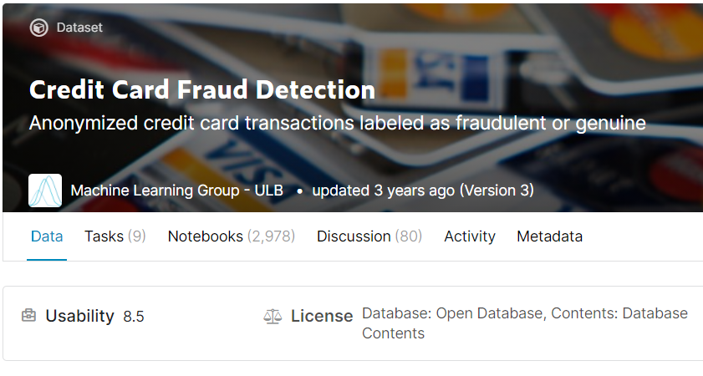
dataset
The dataset contains transactions made by credit cards in September 2013 by European cardholders.
This dataset presents transactions that occurred in two days, where we have 492 frauds out of 284,807 transactions.
The dataset is highly unbalanced, the positive class (frauds) account for 0.172% of all transactions. Features V1, V2, … V28 are the principal components obtained with PCA, the only features which have not been transformed with PCA are 'Time' and 'Amount'.

Slide 9
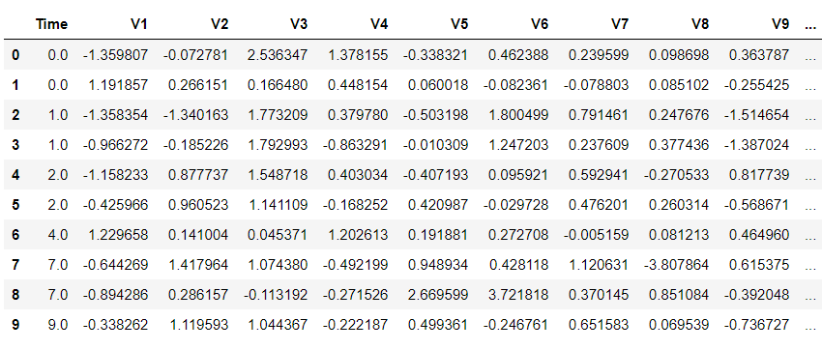
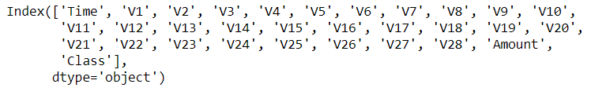
Exploring the Data
The datasets contains 284807 Columns and 34 Columns.
We can see few details of the data in the screenshots provided. The names of the 34 features are displayed as list of columns.
The dataset has no null-values and we are good to go with the next steps like exploring in-depth on each columns/features. The main features which we are going to look are Class, Time and Amount as we might get more information from these features.

Slide 10
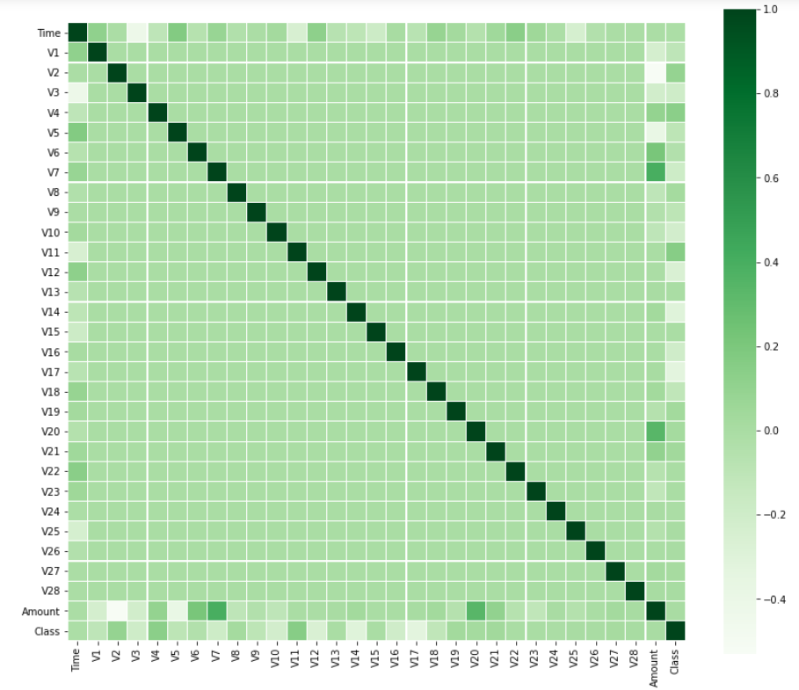
Correlation Matrix

Slide 11
Exploring the Features

Slide 12

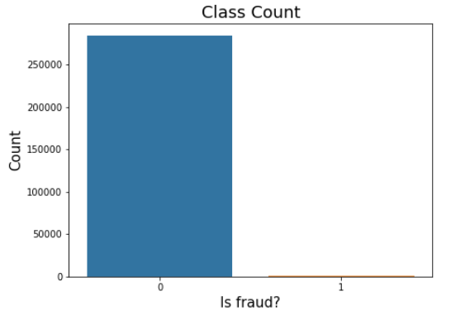
Class
The feature ‘Class’ has only two values i.e.,
0 being ‘Not Fraud’
1 being ‘Fraud’
The difference b/w them is too high making it an imbalanced dataset. We need to handle it.

Slide 13
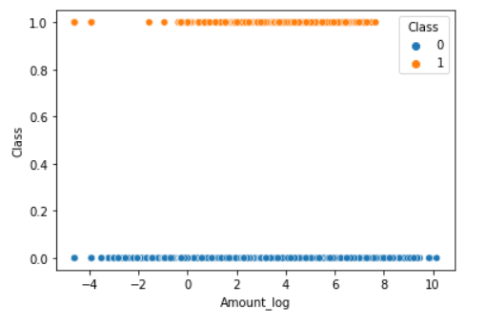
Amount
The feature ‘Amount’ with respect to the feature ‘Class’ is divided into two separate dataframes. One is fraud and the other one is Normal.
The Scatter plot between the fraud and normal vs Class category is shown in the figure where ‘0’ being ‘Normal’ and ‘1’ being ‘Fraud’

Slide 14
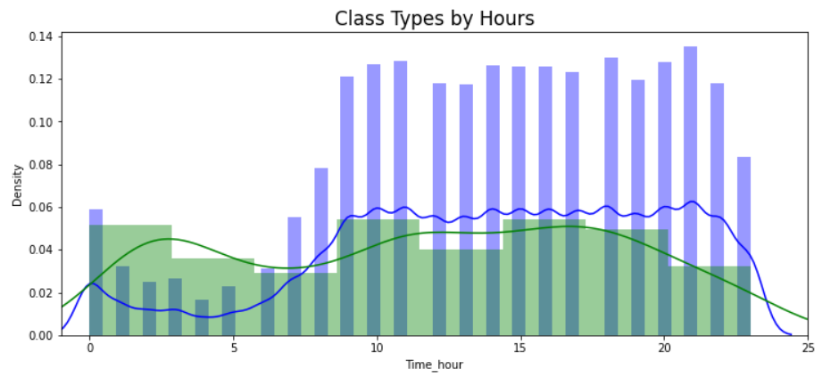
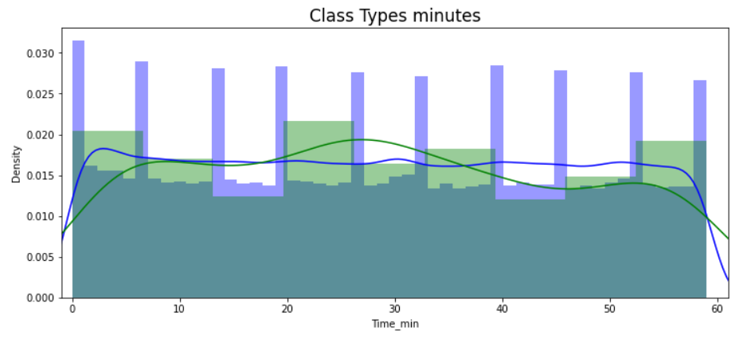
Time
Initially, the feature ‘Time’ is separated into two dataframes as time_min and time_hr.
The dist plots of time_hr and time_min vs Class category is shown in the figures where ‘0’ being ‘blue’ and ‘1’ being ‘green’.

Slide 15
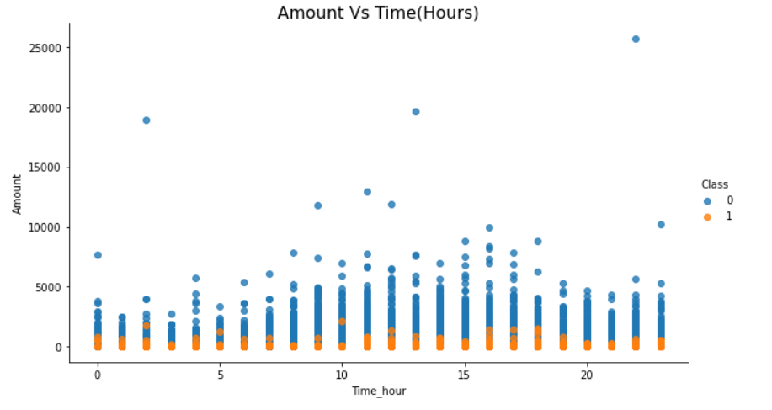
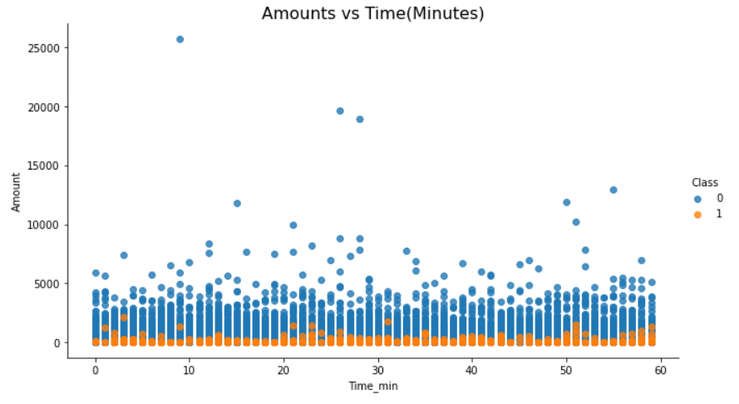
Time(Contnd..)
The dist plots of time_hr and time_min vs Amount with respect to Class Category is shown in the figures.

Slide 16
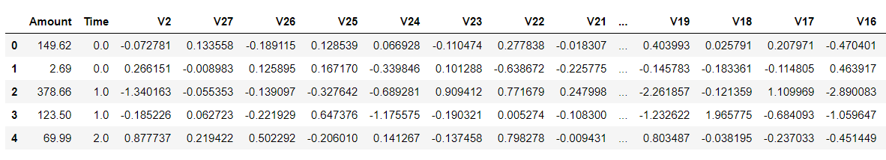
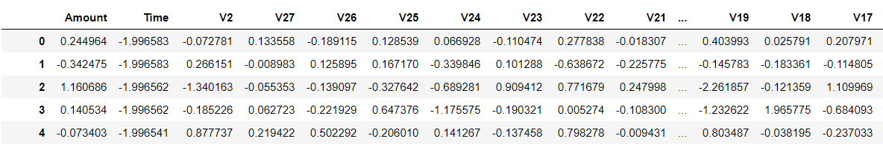
Feature selection
After selecting the features using LassoCV Model, here are the figs., of few features before & after applying StandardScaler to ‘Amount’ and ‘Time’.

Slide 17
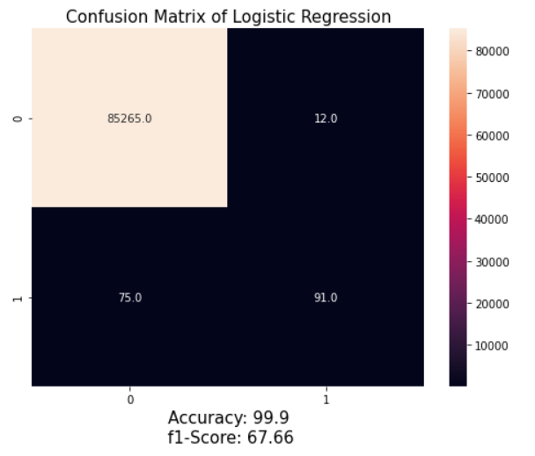
Logistic Regression (Imbalanced Data)

Slide 18
Techniques used to handle imbalanced data
UnderSampling
UnderSampling – NearMiss
OverSampling
OverSampling – SMOTE
Logistic Regression – Cost Sensitive
XGBoost

Slide 19
Outcomes of models used

Slide 20
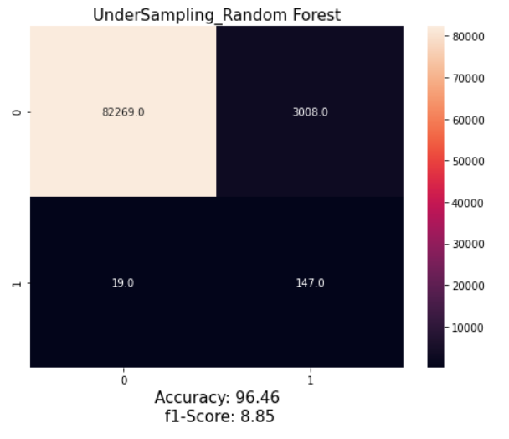
UnderSampling (RandomForest)

Slide 21
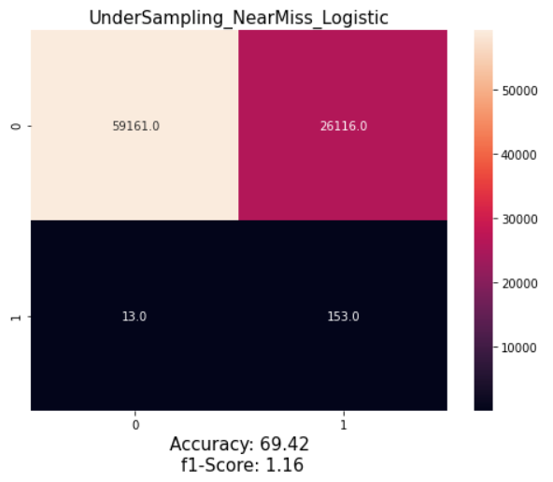
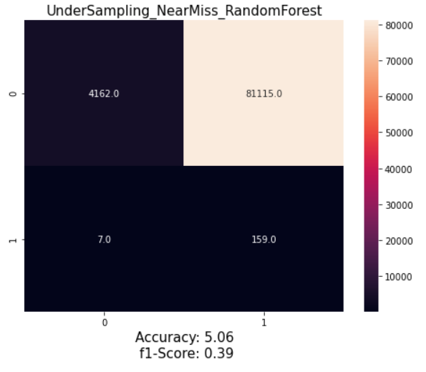
UnderSampling-NearMiss (Logistic & RandomForest)

Slide 22
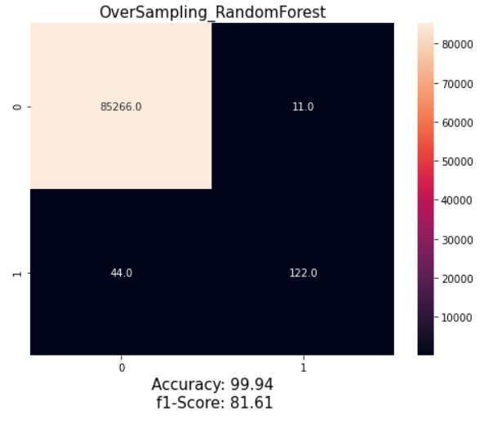
overSampling (RandomForest)

Slide 23
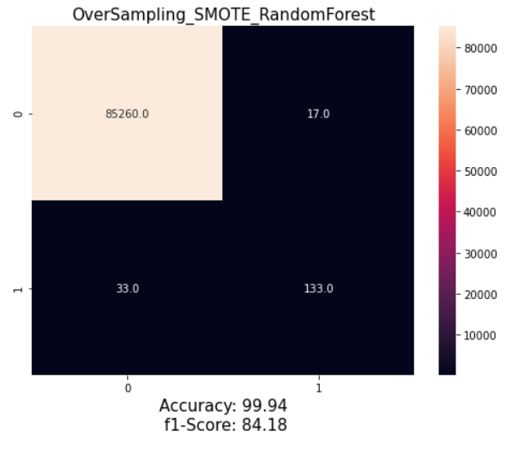
oversampling - Smote (RandomForest)

Slide 24
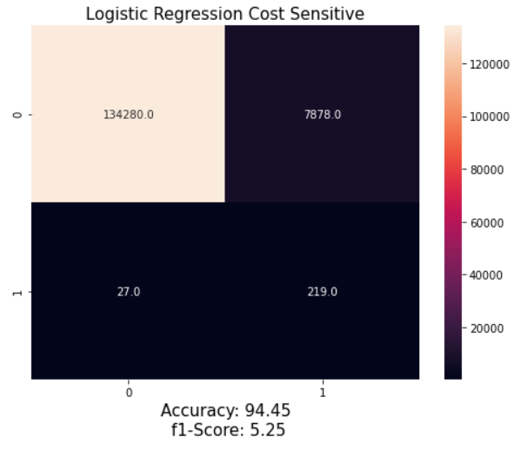
Logistic Regression - Cost Sensitive

Slide 25
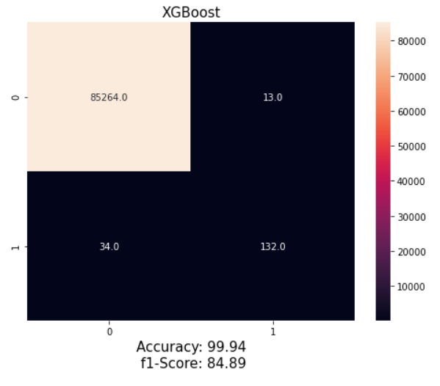
XGBoost

Slide 26
Comparison

Slide 27
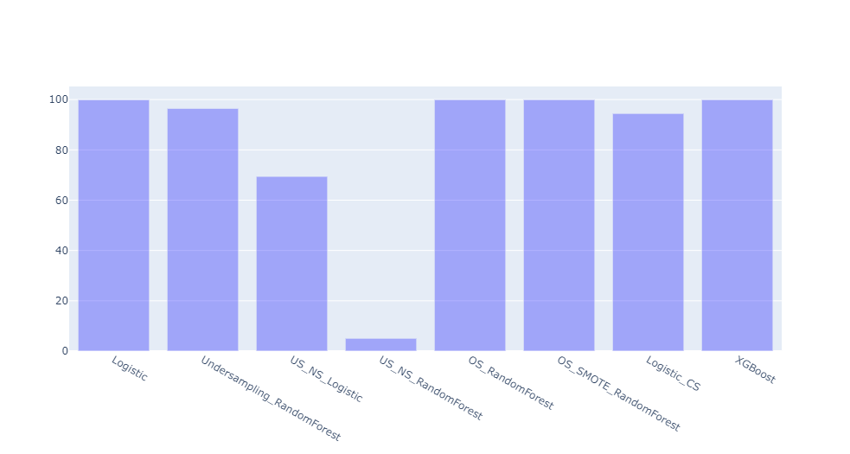
Accuracies of All Models

Slide 28
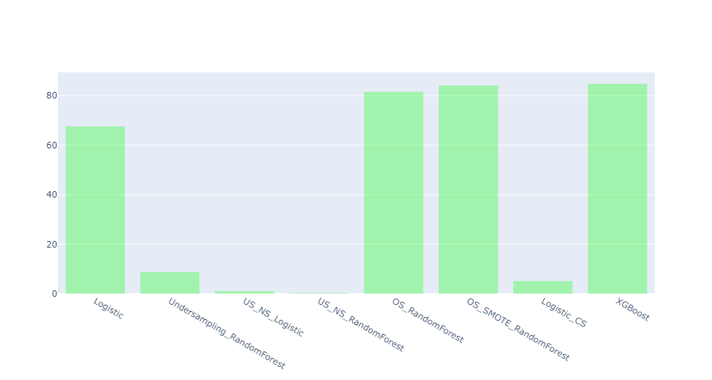
F1-Scores of All Models

Slide 29
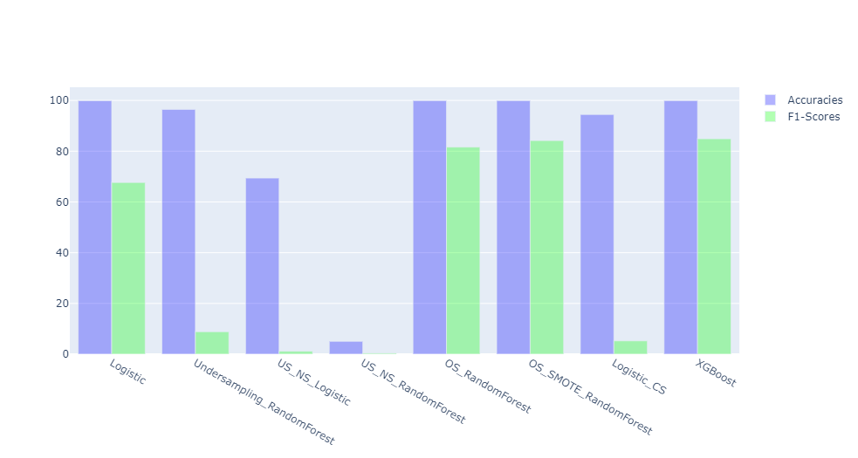
All at one place-1

Slide 30
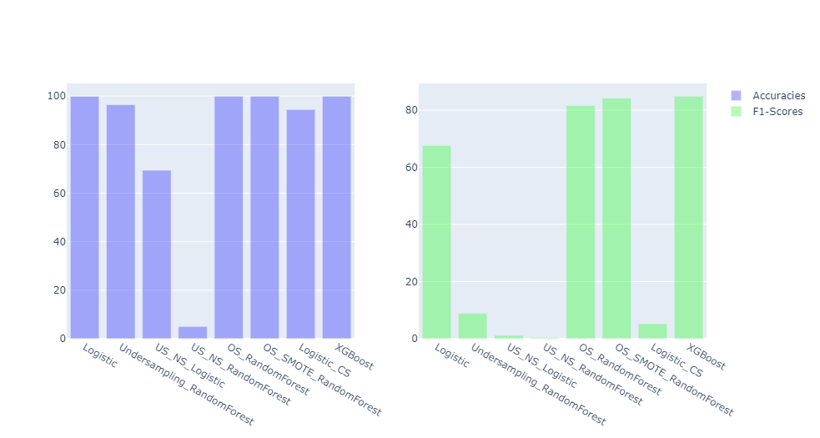
All at one place-2

Slide 31
Thank you!

